Slide 1

Tableau Workshop
Rob Segan, Reema Rustagi
Date and/or Location of Presentation

Slide 2
Tableau Installation

Slide 3

Tableau for Students
Tableau Academic Program:
www.tableau.com/academic/students

Slide 4
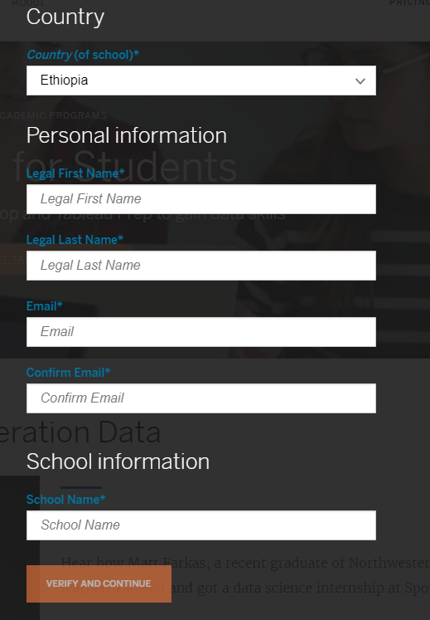
Verify Your Student Identity
You will receive an email from Tableau with instruction of how to download and activate Tableau

Slide 5
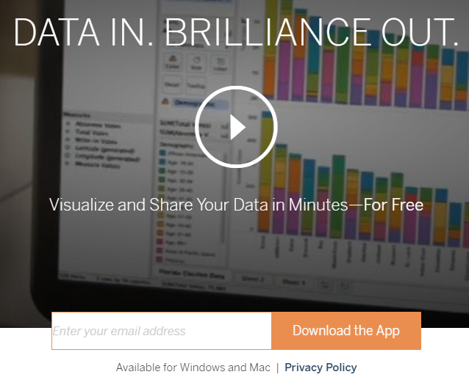
Tableau for Public
Tableau Public: public.tableau.com
Enter
your
Email

Slide 6

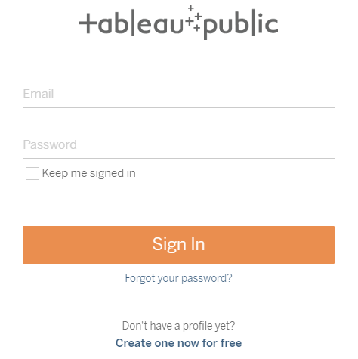
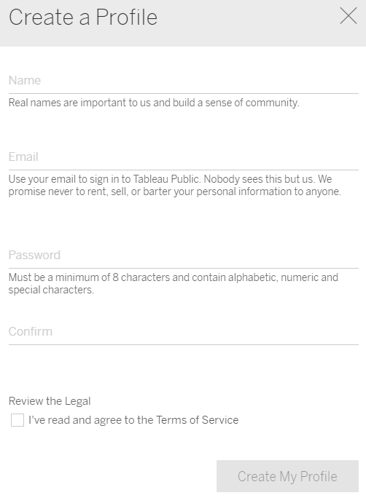
Create Tableau Public Profile to Share Your Work
Tableau Public: public.tableau.com
Right upper corner:
Create profile
Create

Slide 7
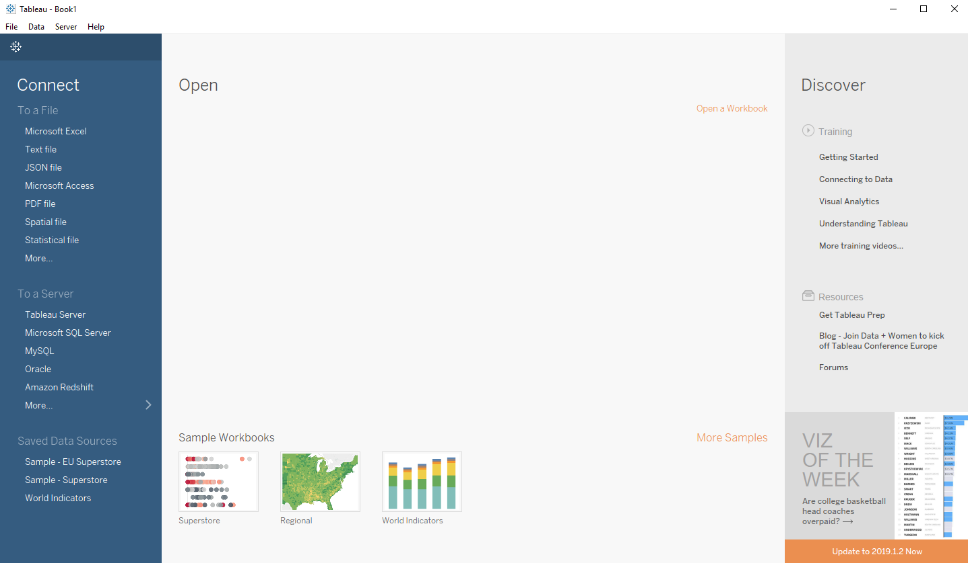
Open Tableau!
If you see above picture, you are ready to go!

Slide 8
Build Your Own Data Visualization in Tableau
Ethiopia HIV Prevalence

Slide 9
Data
- Understand data and make data useful
Today:
- Data cleaning
Visualize
- Choose right visualization format
Today:
- Line chart
- Choropleth map
- Dashboard
Share
- Share your work for public good
Today:
- Publish to Tableau public
- Share on CGDV

Slide 10

About Data
HIV Prevalence in Ethiopia from 1992 to 2017
Population: Adult Age 15 - 49
Data source: UNAIDS
aidsinfo.unaids.org
Example data: https://github.com/CGDV/CGDV.github.io/tree/master/workshop/Tableau/data

Slide 11
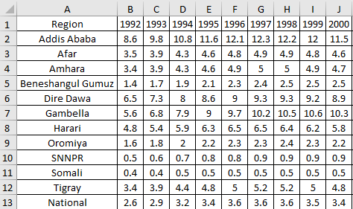
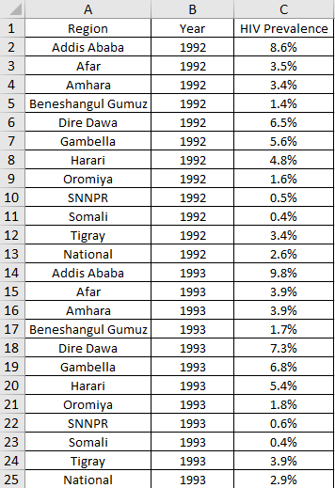
Data Cleaning
Tidy Data (by Hadley Wickham)
Each variable is saved in its own column
Each observation is saved in its own row
Each “type” of observation stored in a single table (here prevalence).
Why Tidy Data?
Easy to access variables
Automatically preserves observations

Slide 12
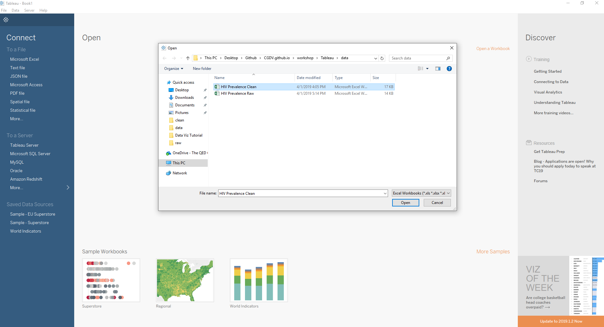


Import Data to Tableau

Slide 13
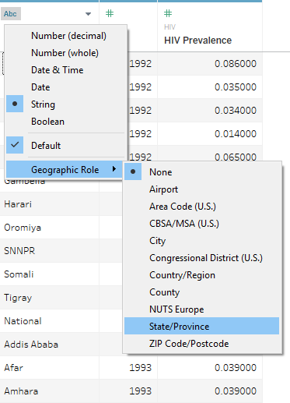
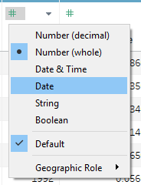
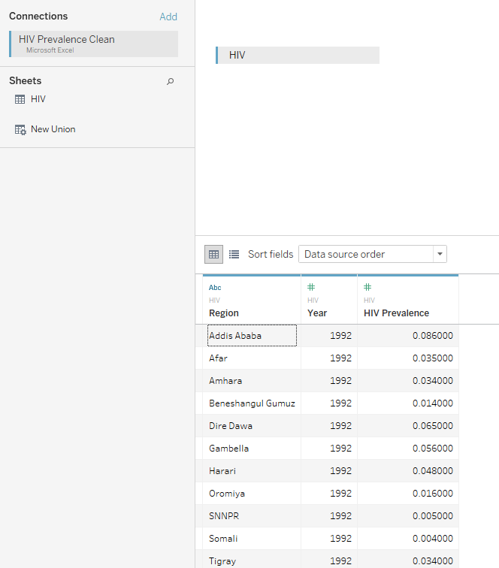
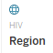
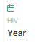
Choose Right Data Type
Region
Year

Slide 14
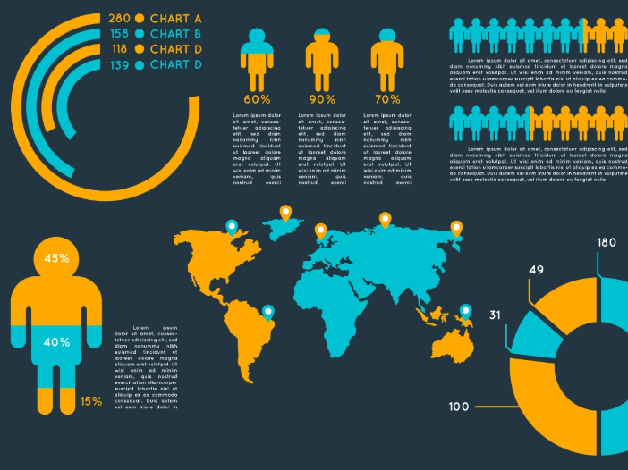
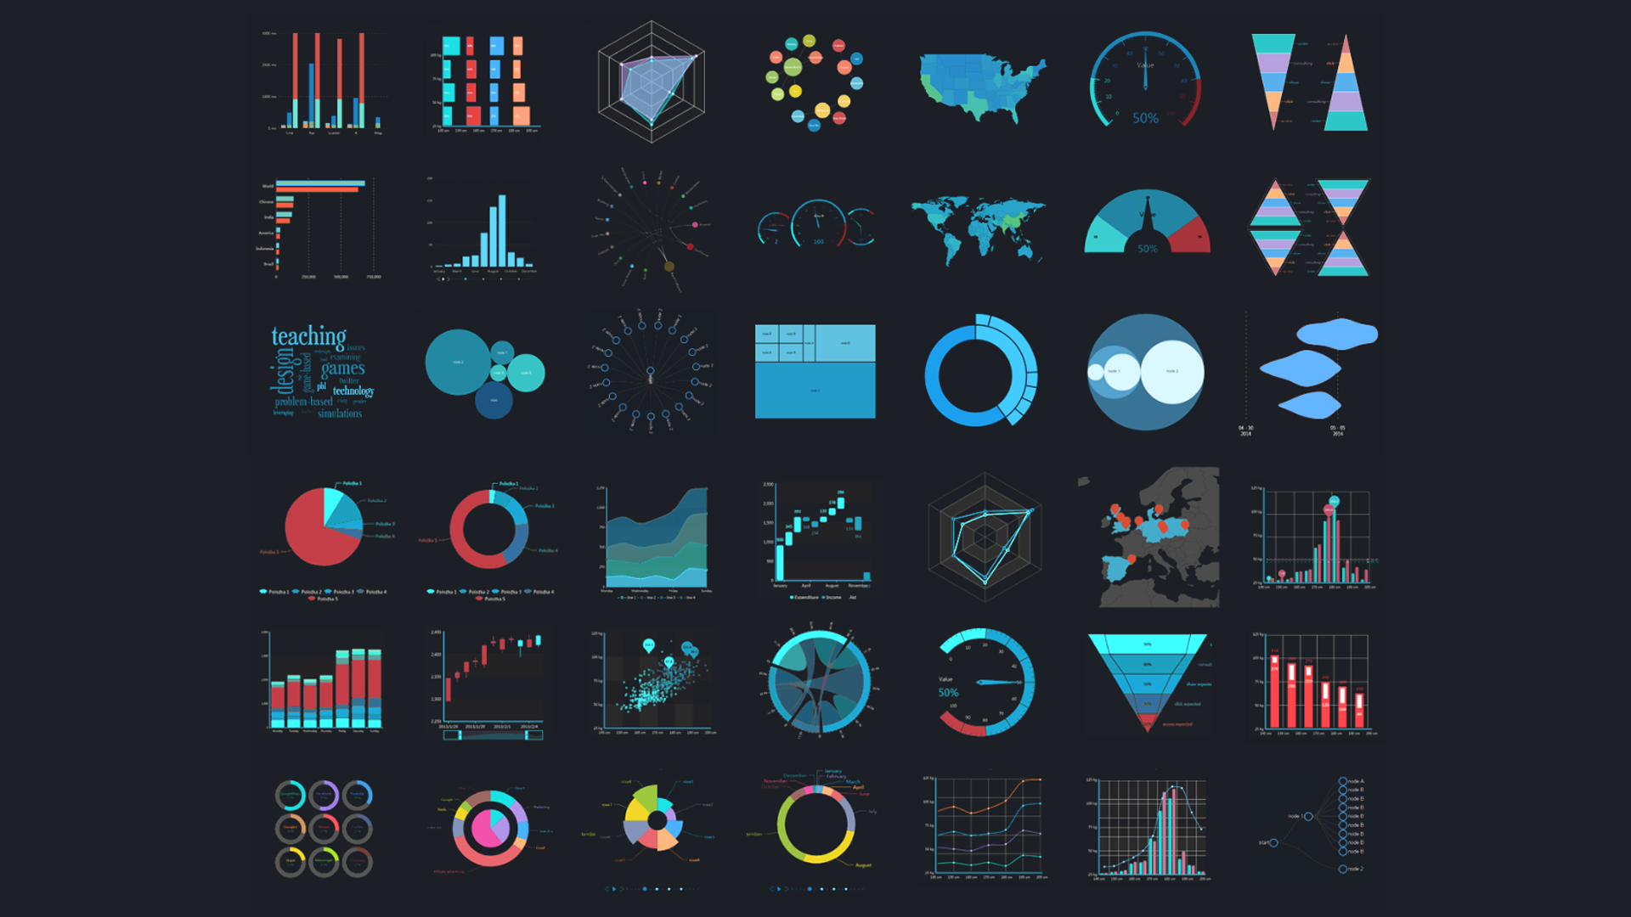
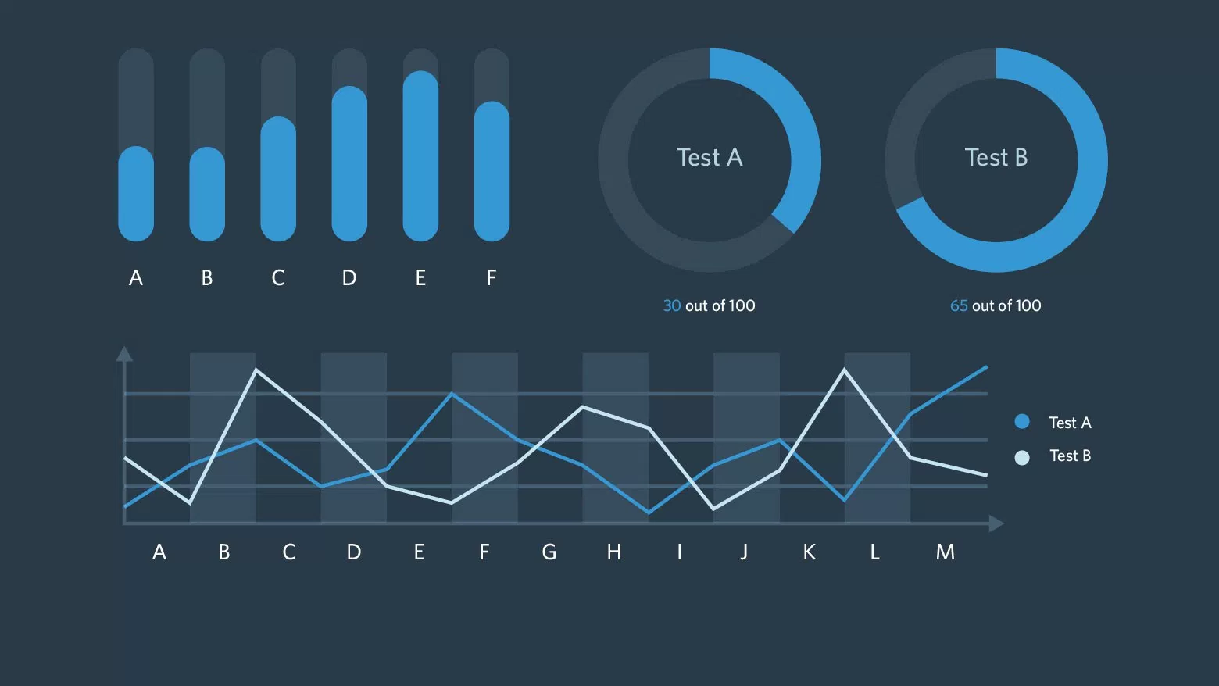
Let’s Visualize Data!

Slide 15
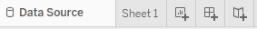
Tableau 101
Sheet < Dashboard < Story
Sheet: Single visualization
Dashboard: Multiple sheets
Story: Multiple sheets + dashborads

Slide 16
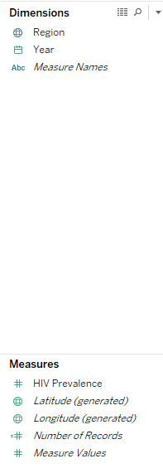
Tableau 101 Dimensions vs Measures
Dimensions:
- Level of detail
- How to want to separate data?
(location, date…)
Measures
- Aggregation
- How to want to calculate data?
(Average, count, …)

Slide 17
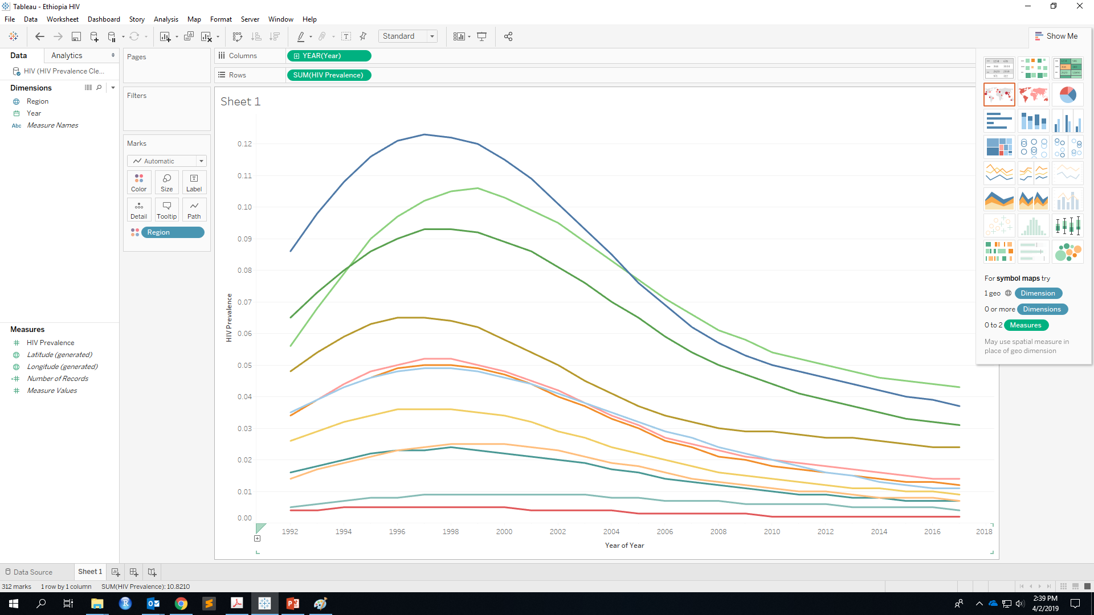

Line Chart
Drag!

Slide 18
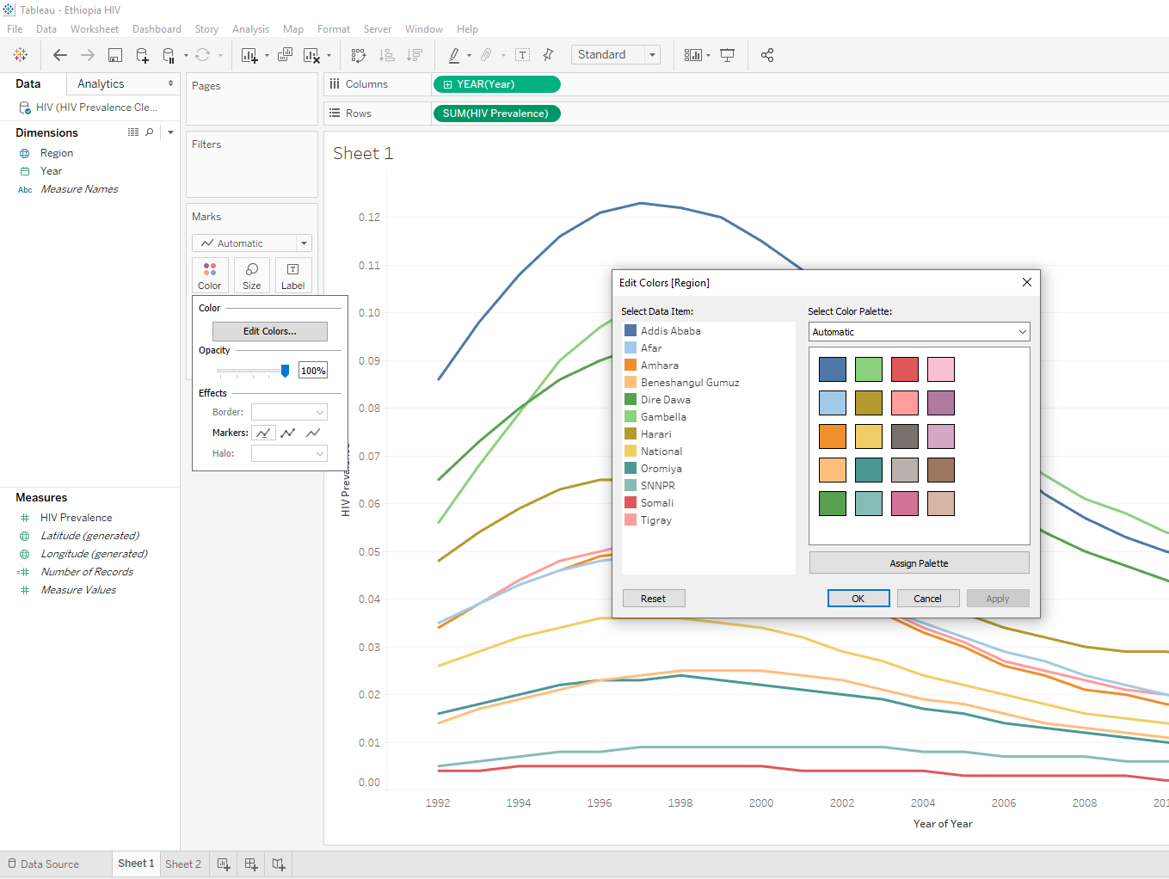
Customize Color
Customize line color

Slide 19
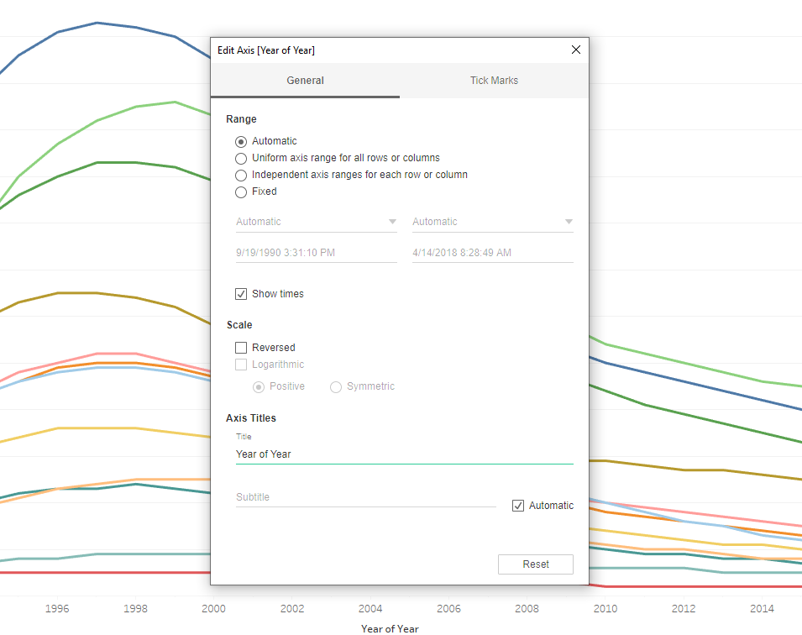

Customize Axis
Double click to edit axis

Slide 20
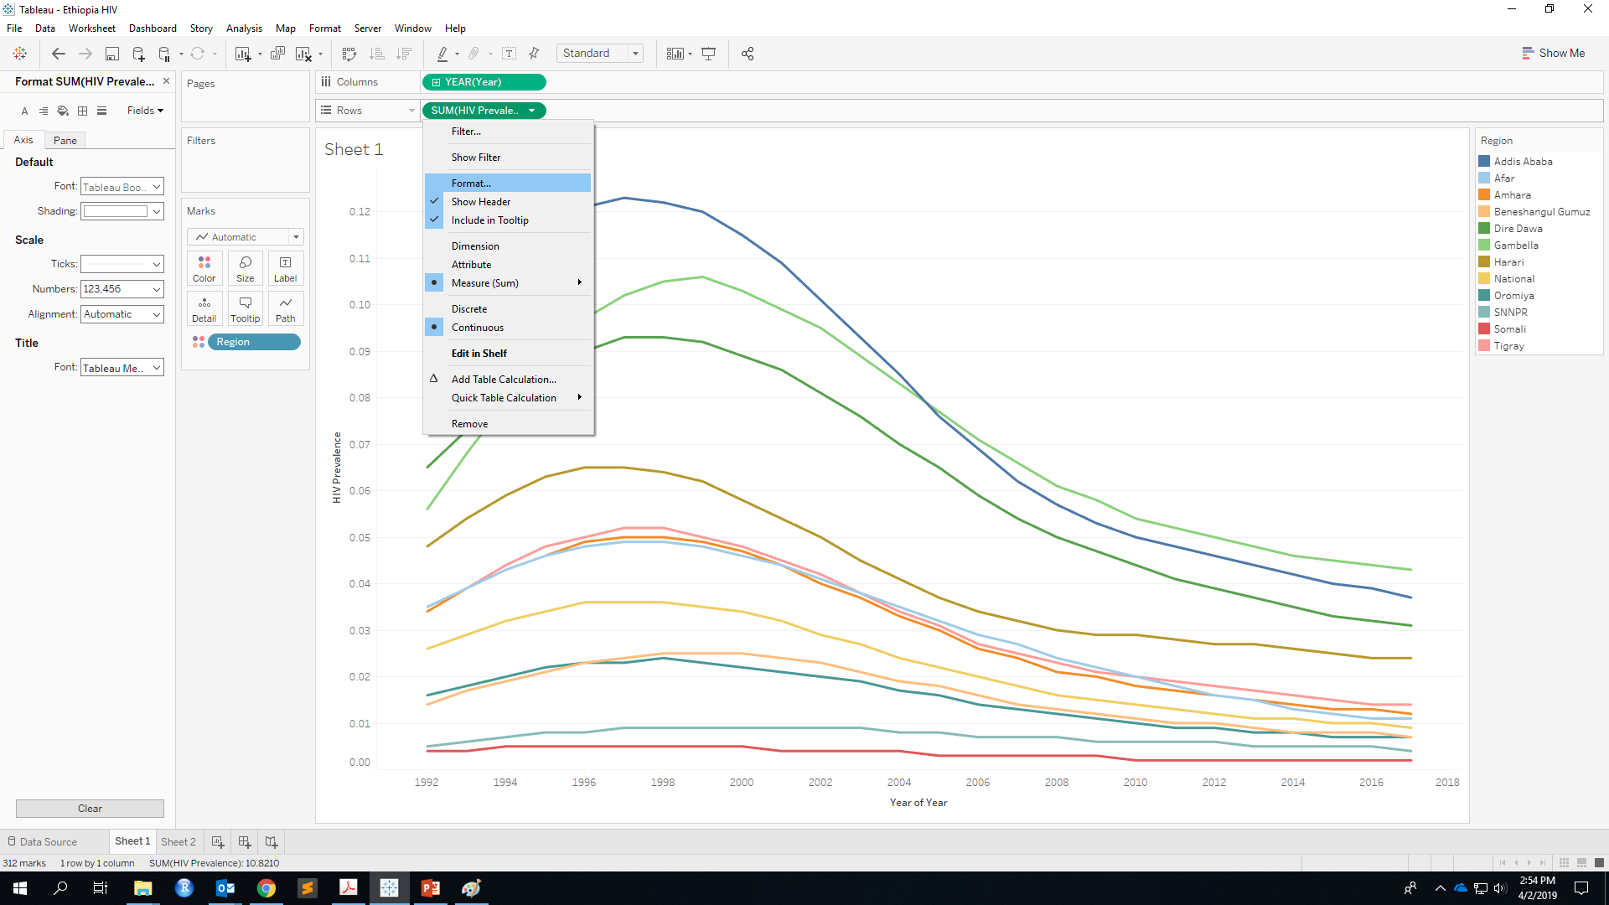
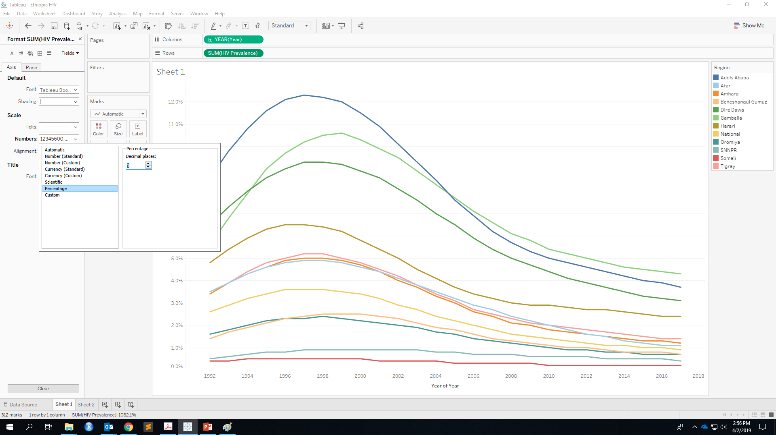
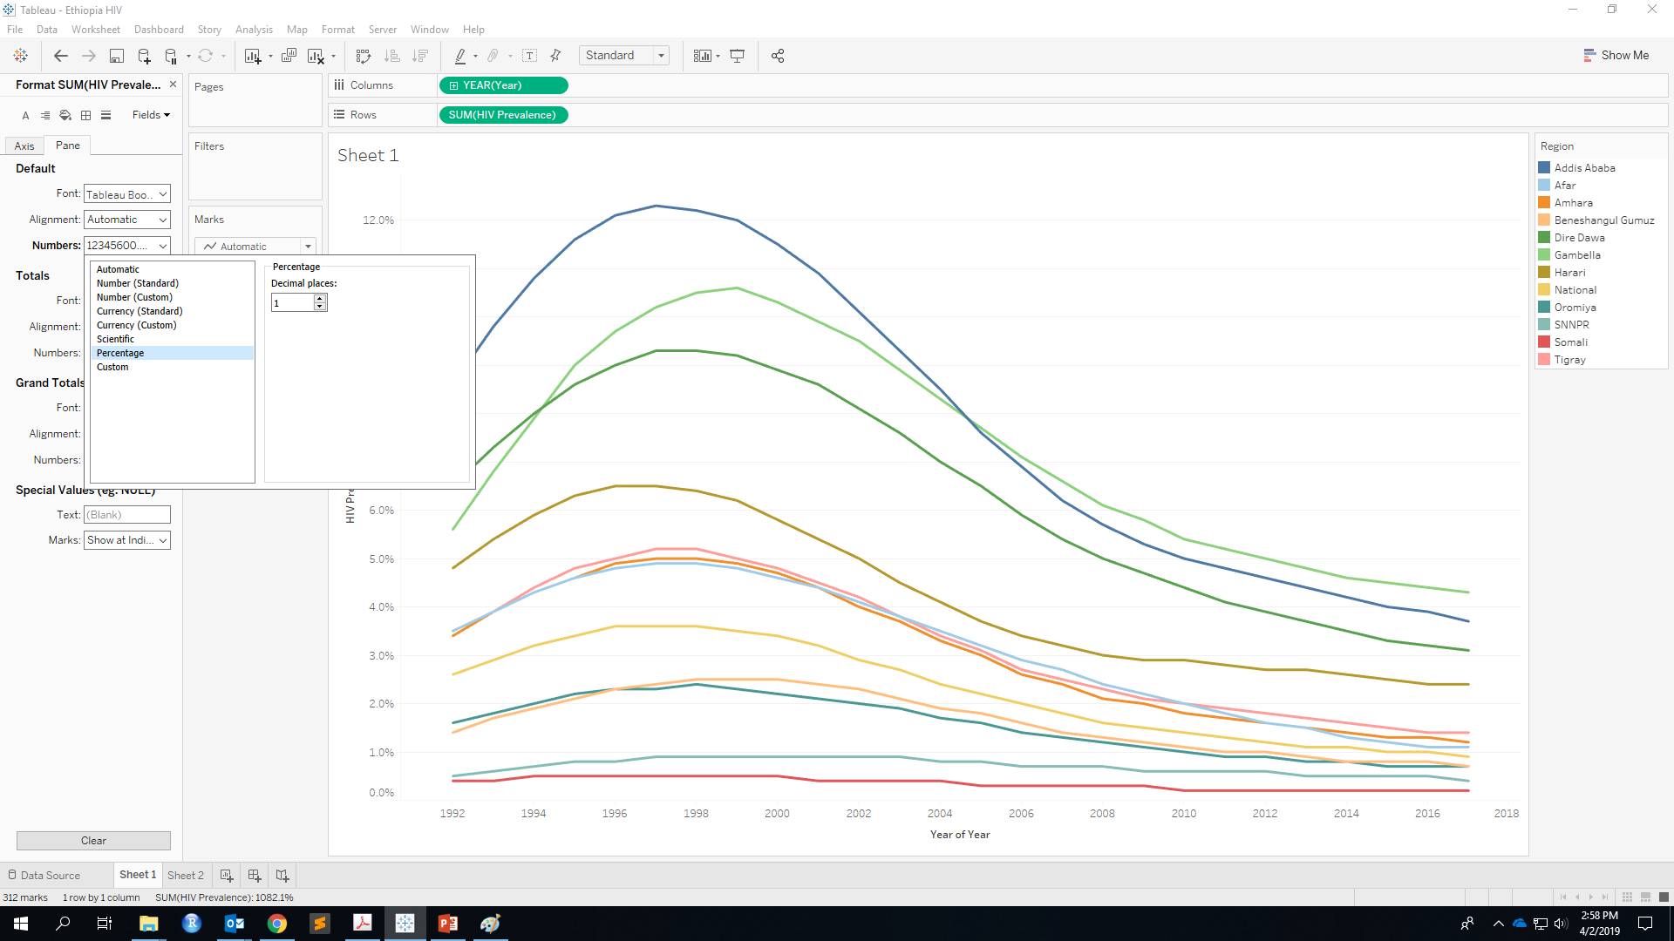
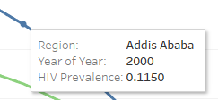
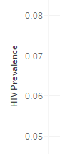
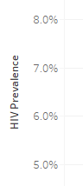
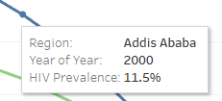
Show as Percentage

Slide 21
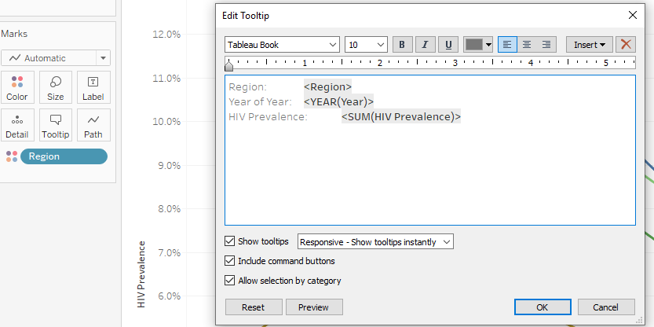
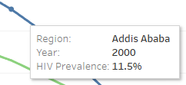
Customize Tooltip

Slide 22
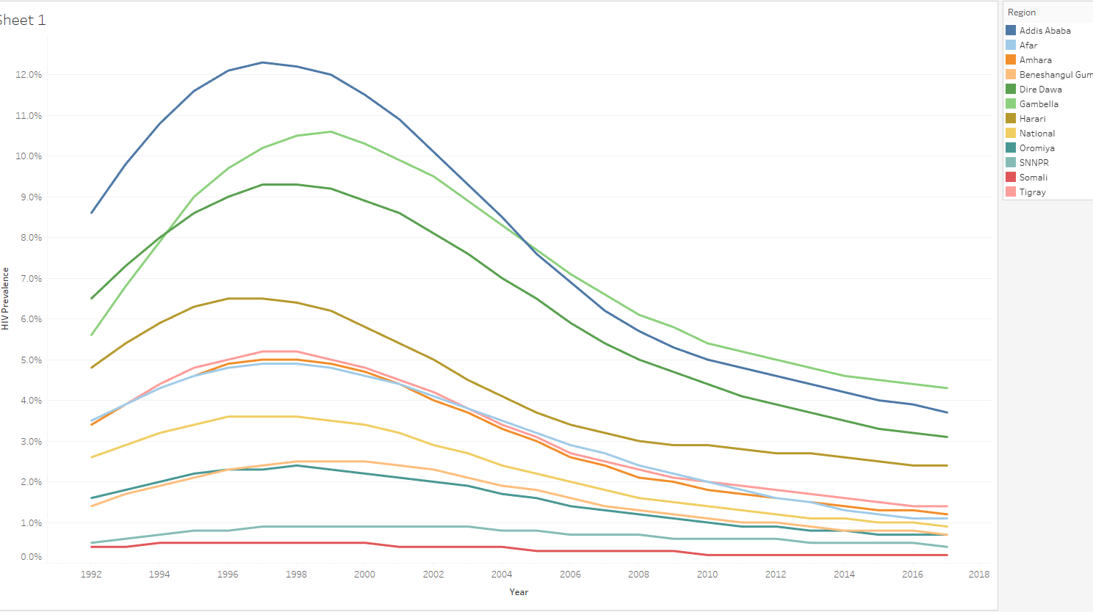
Line Chart Done!

Slide 23
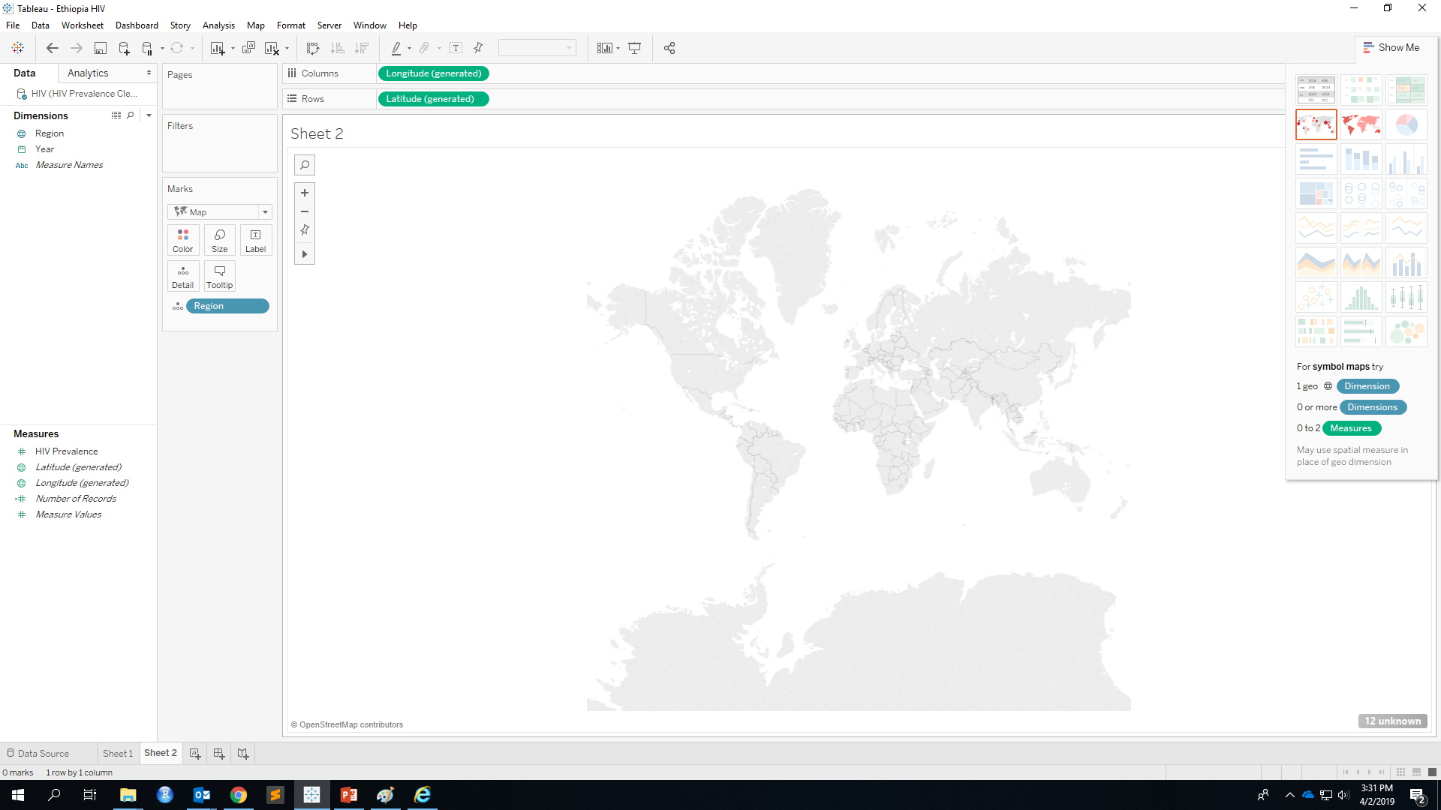
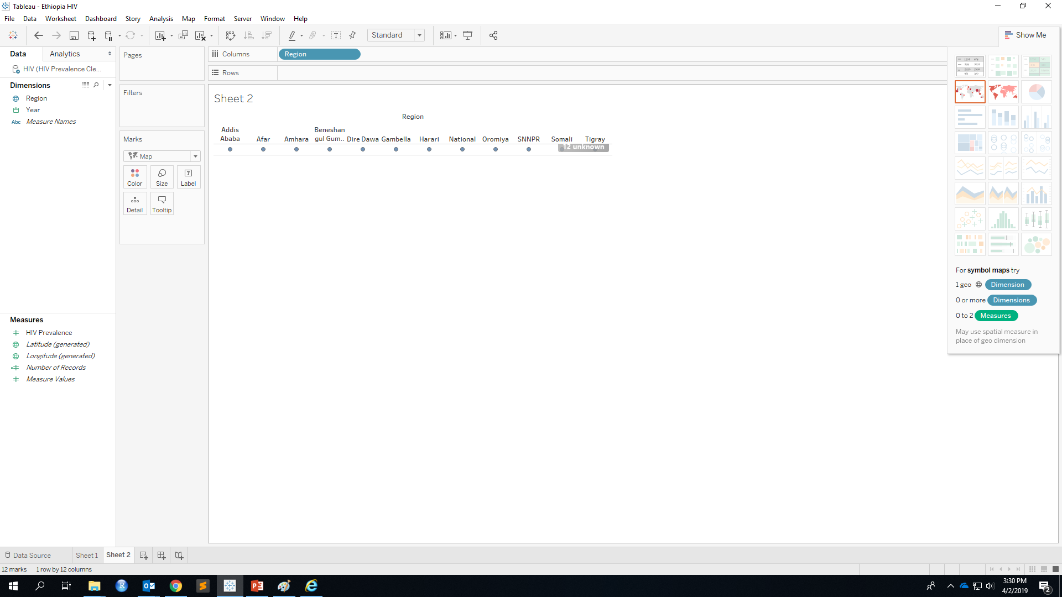
Choropleth Map

Slide 24

Match Location
Why nothing on the map?
We have unknown geographic locations!

Slide 25
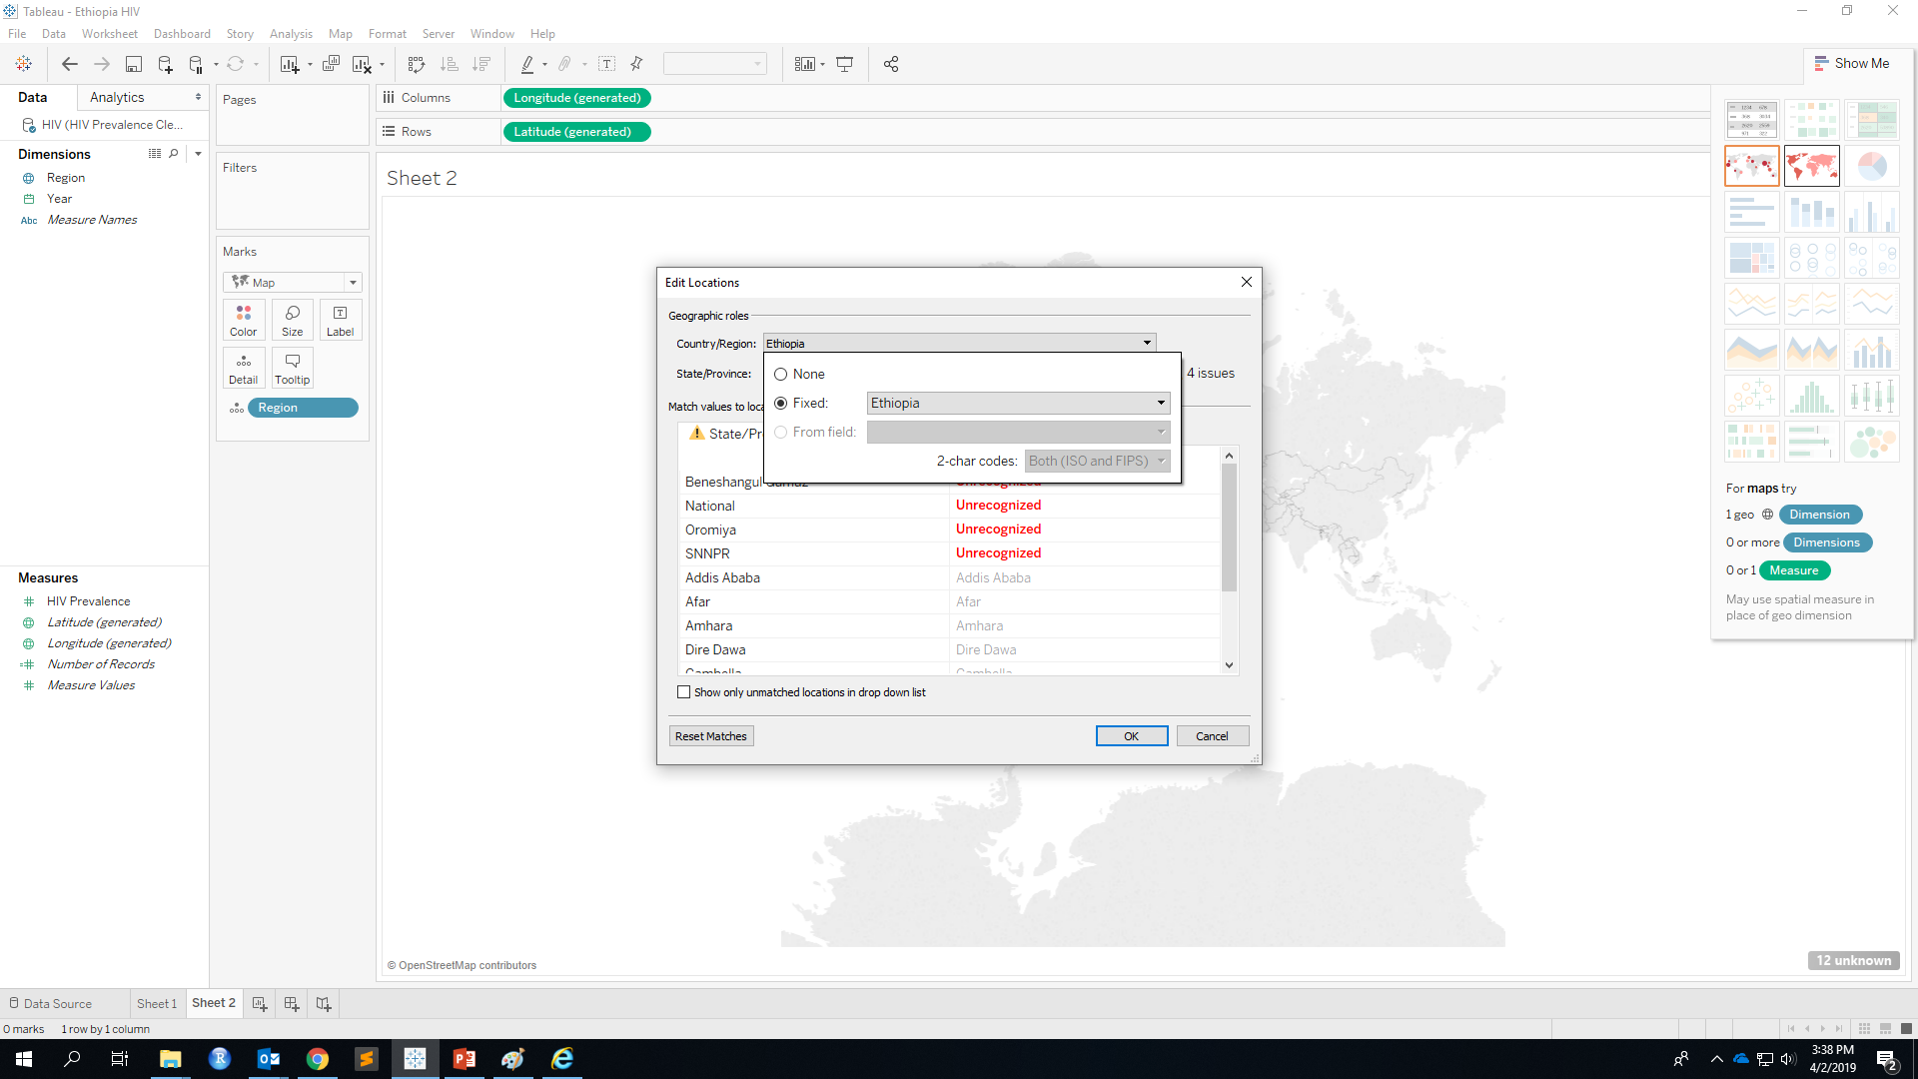
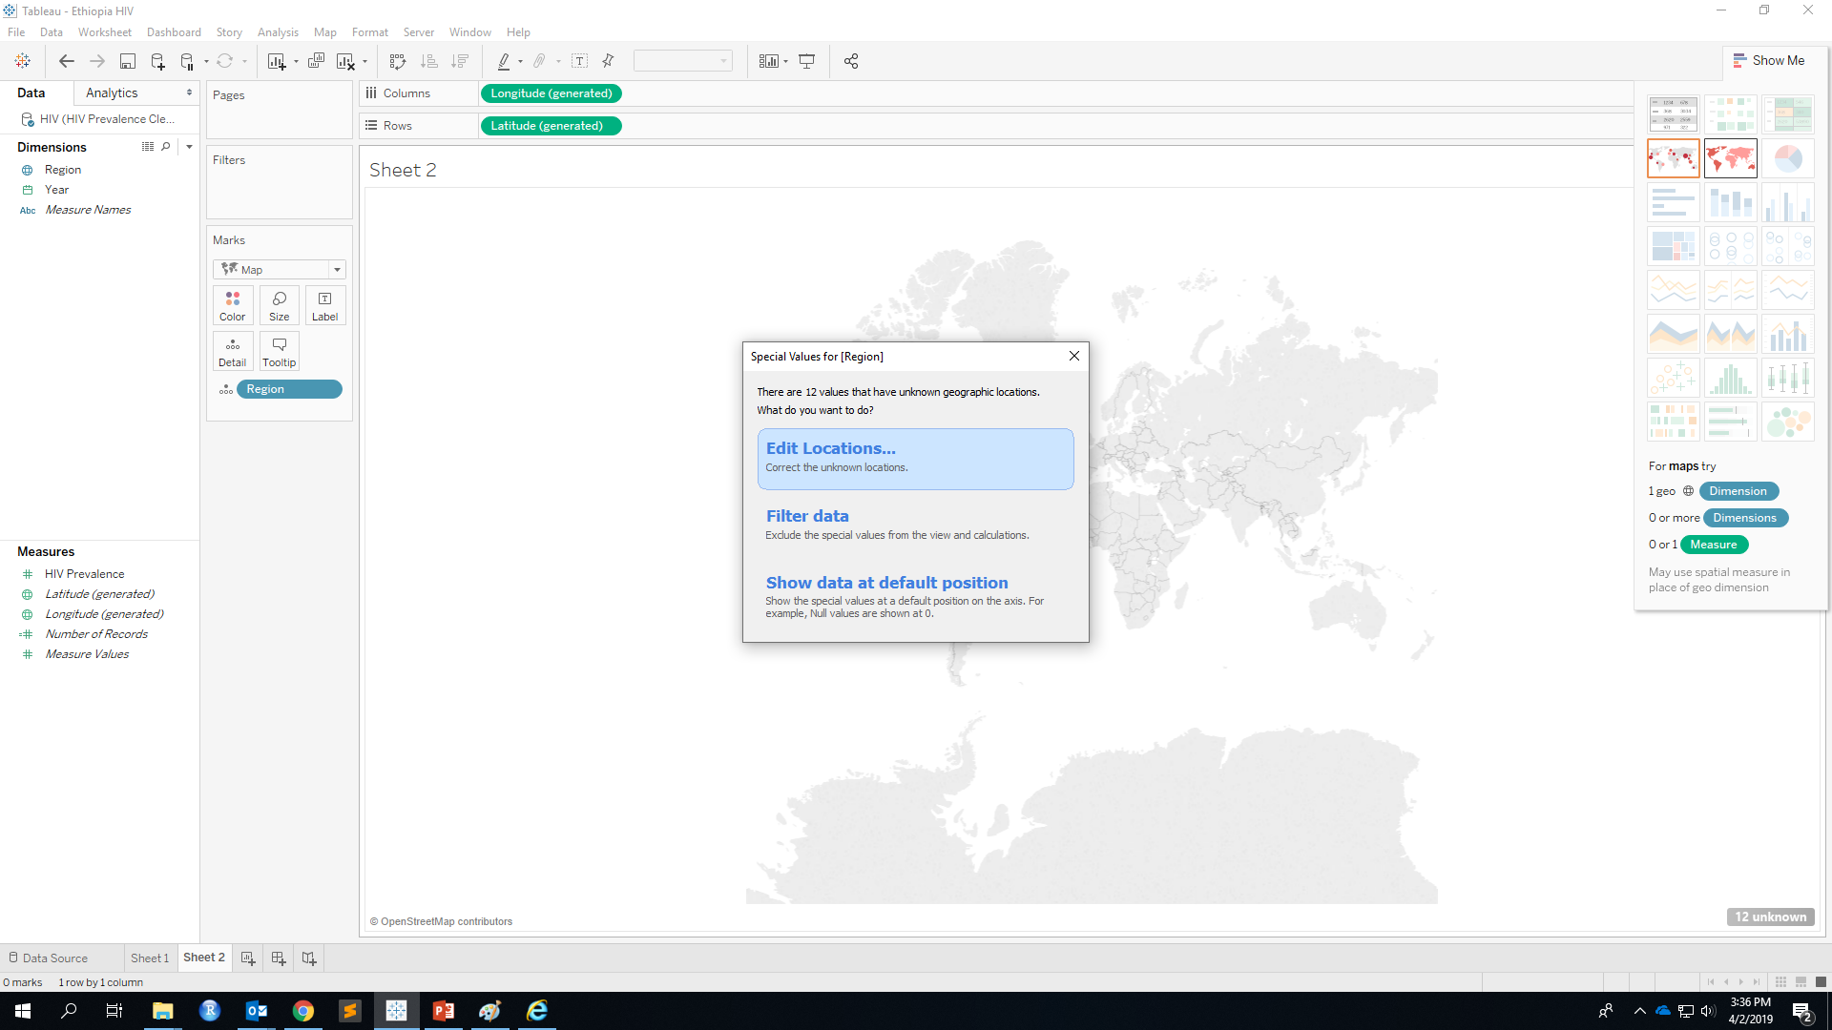
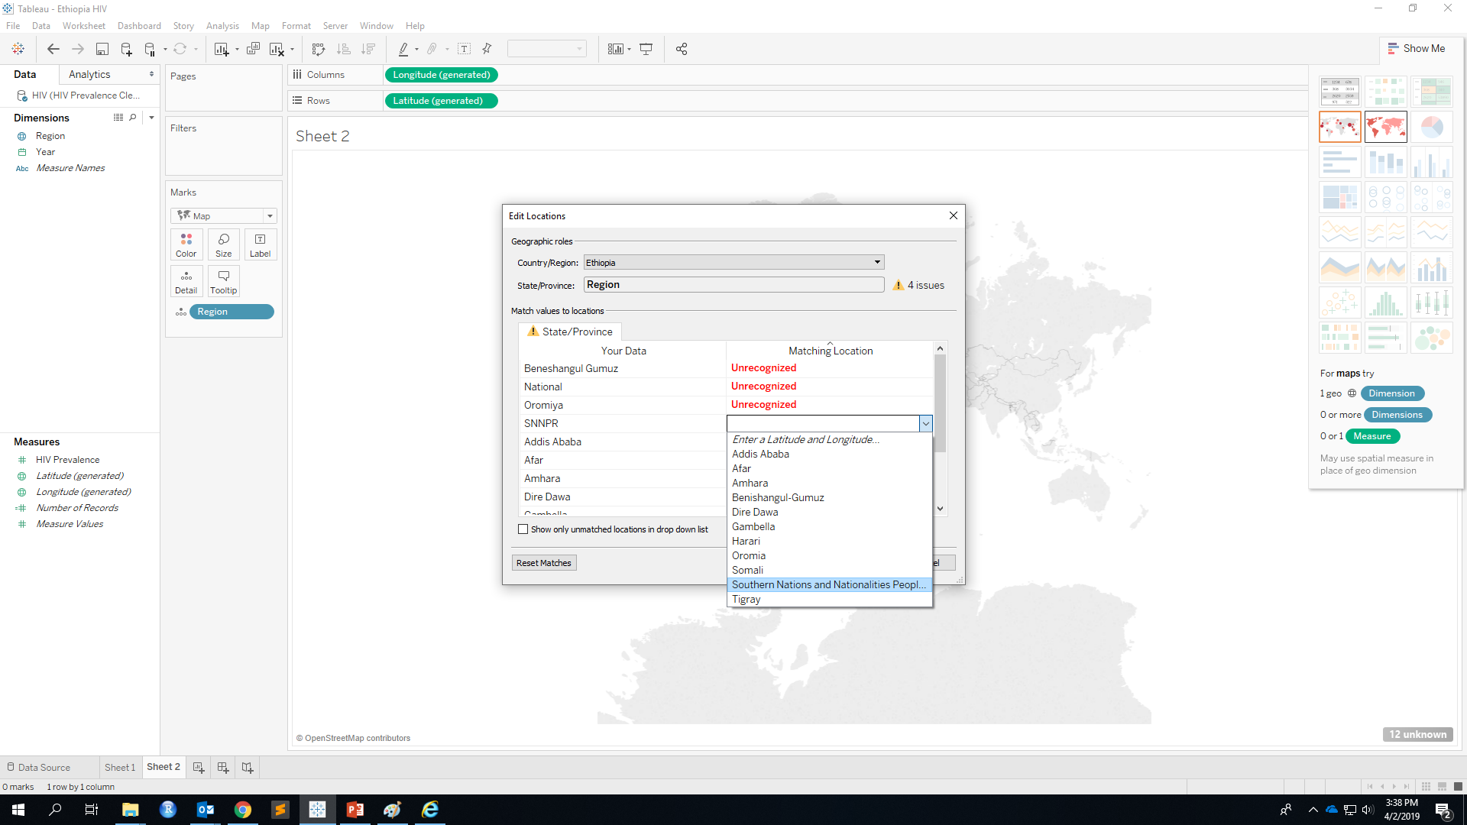
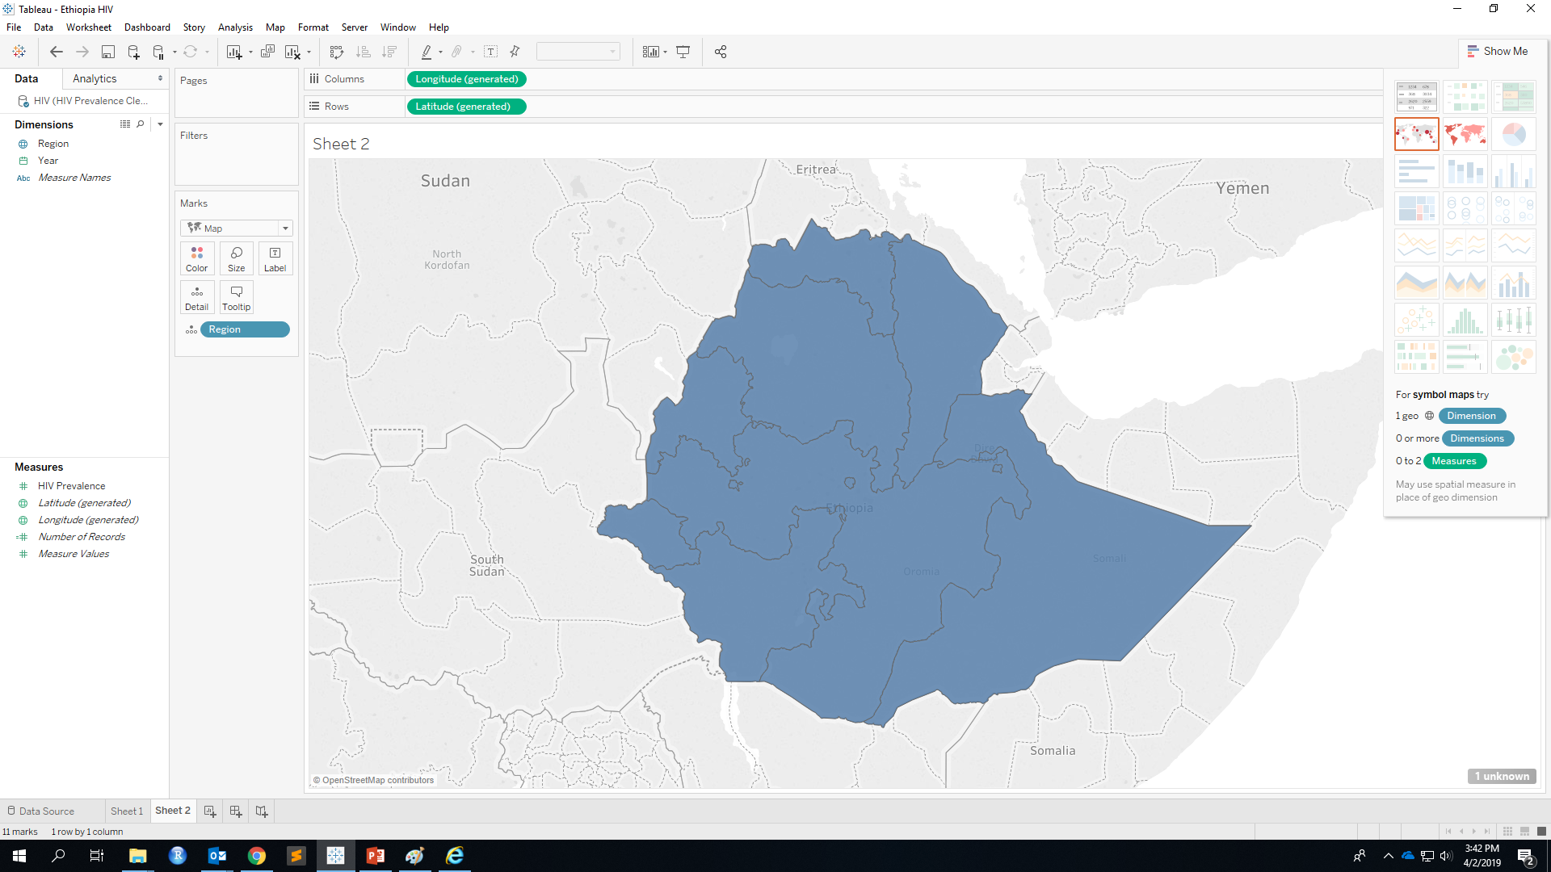
Edit Locations
Select Country
Match Unrecognized
Region

Slide 26
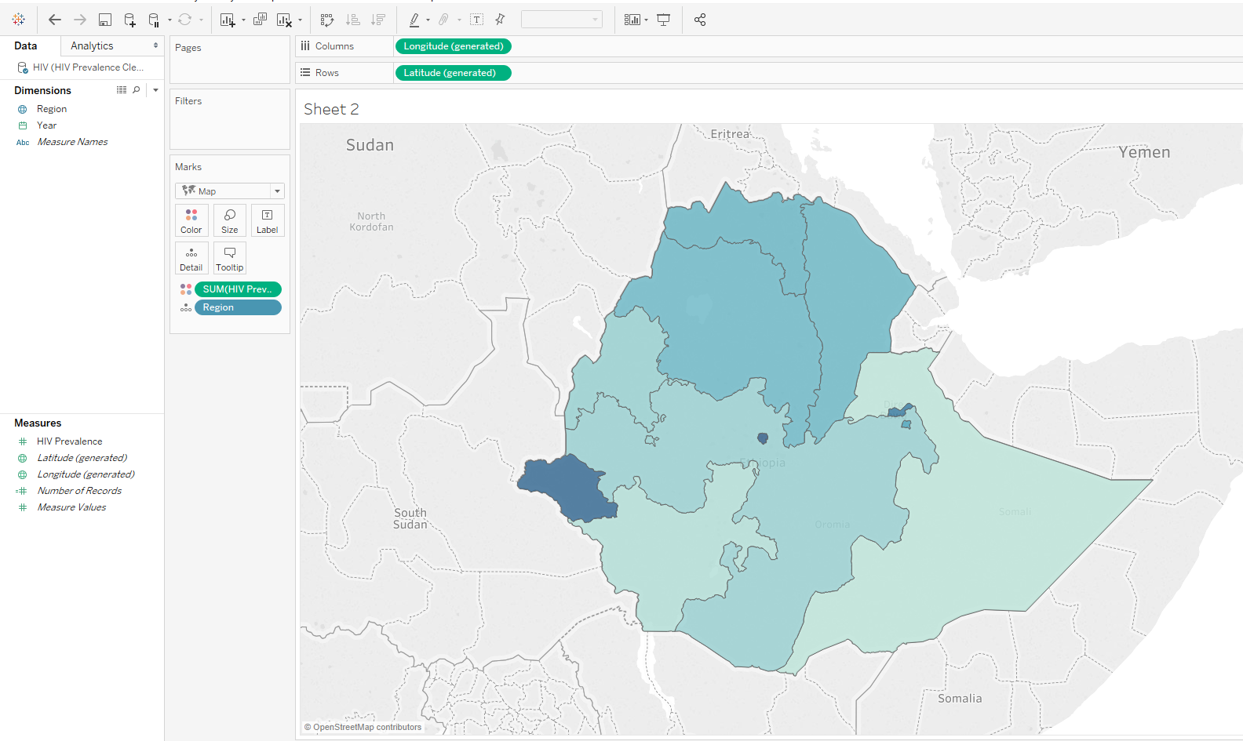
Color
Drag HIV Prevalence to Color
Color here shows sum of prevalence over past 25 years, NOT what we want!!!!

Slide 27
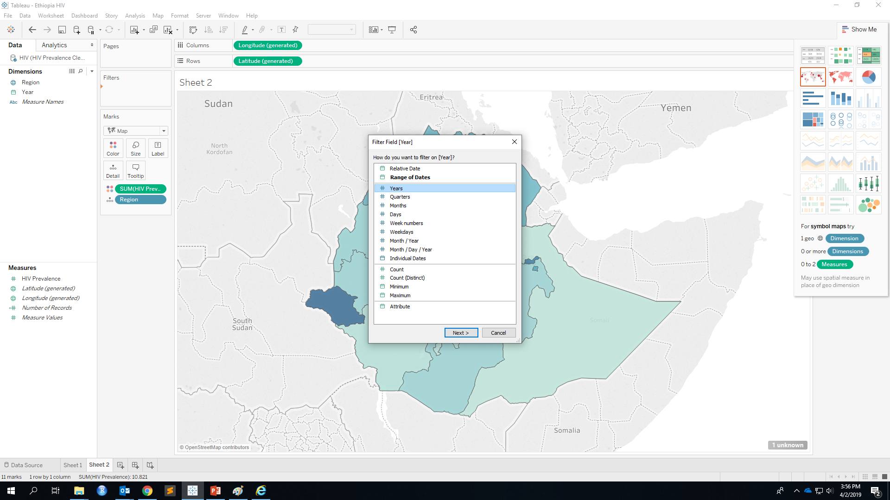
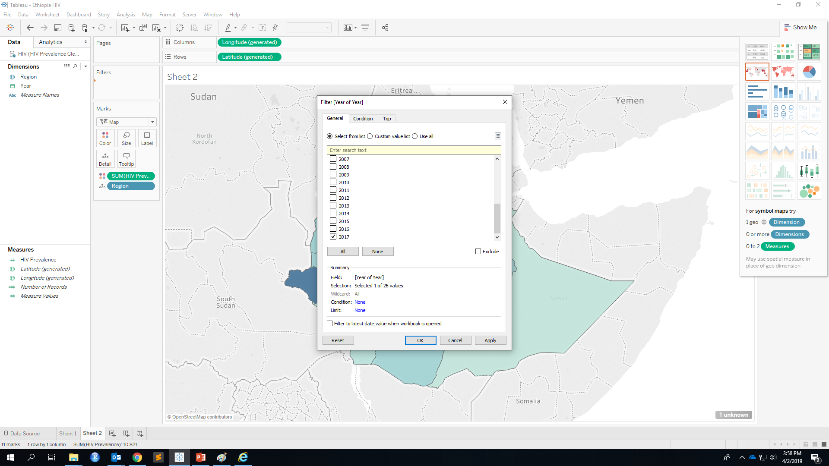
Filter by Year
Choose single year you want to visualize
Drag Year to Filter

Slide 28
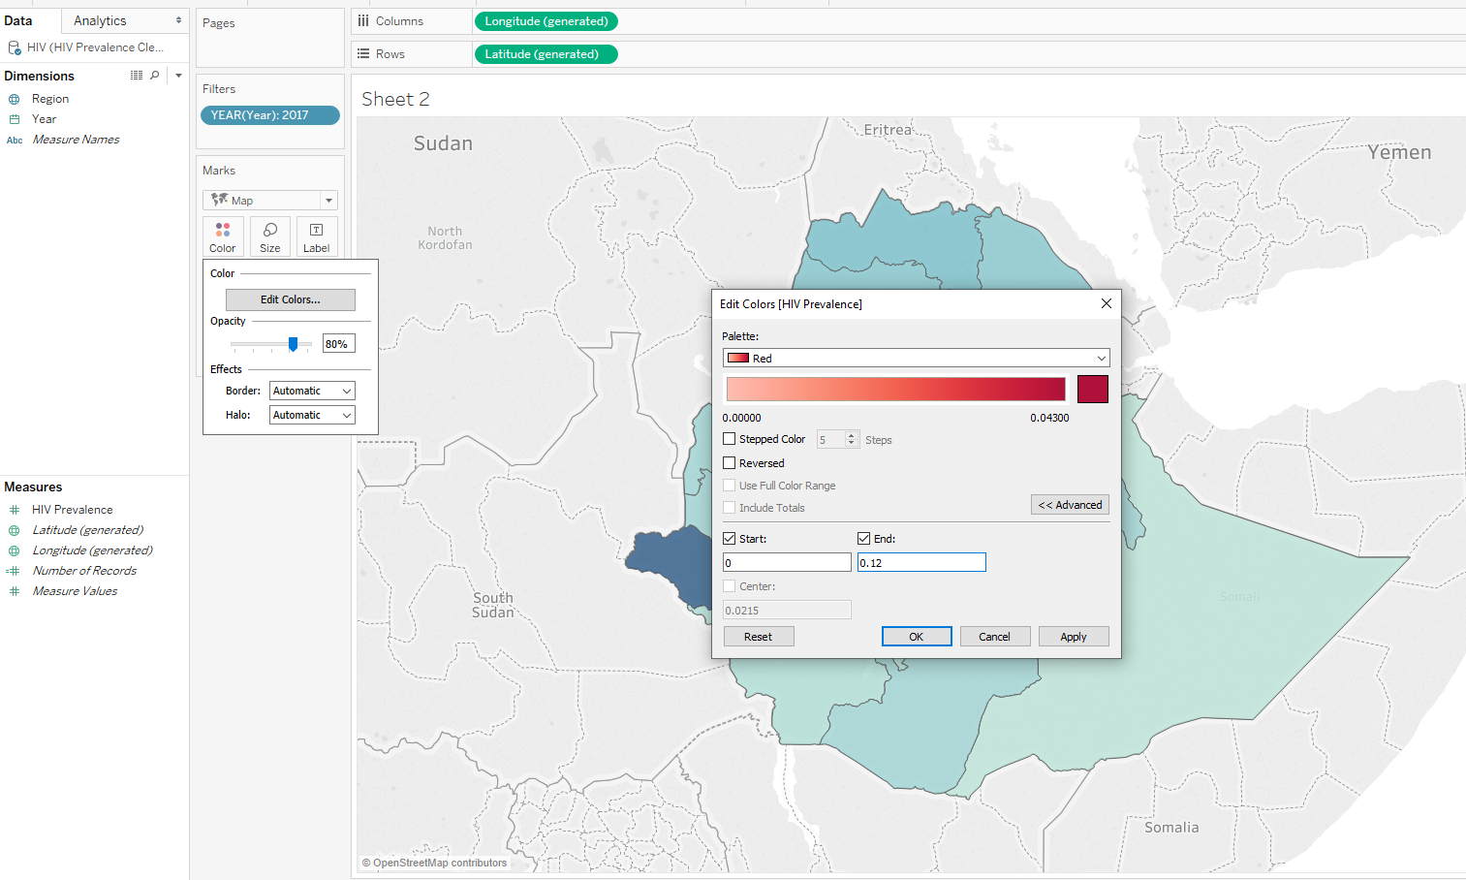
Customize Color
Choose Palette
In Advanced, fix value range

Slide 29
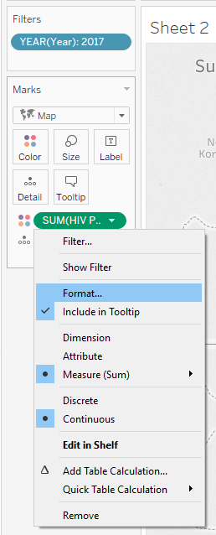
Show as Percentage

Slide 30
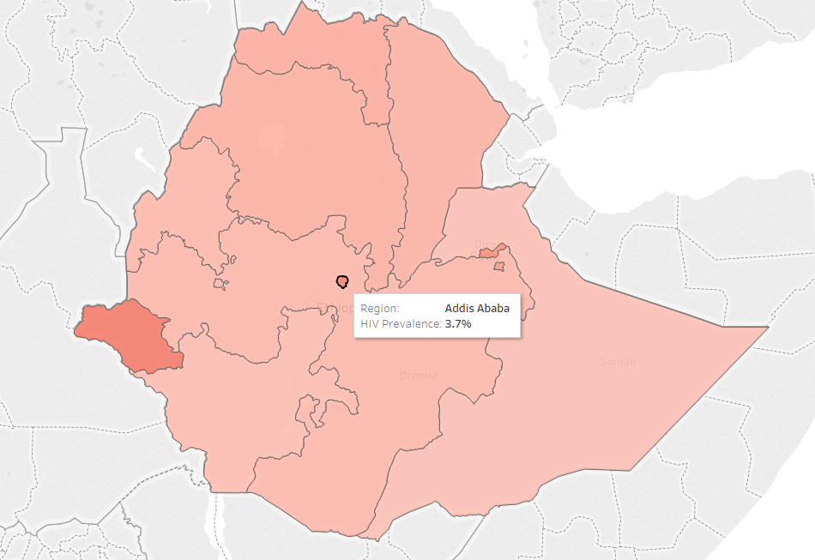
Choropleth Map Done!

Slide 31
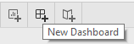
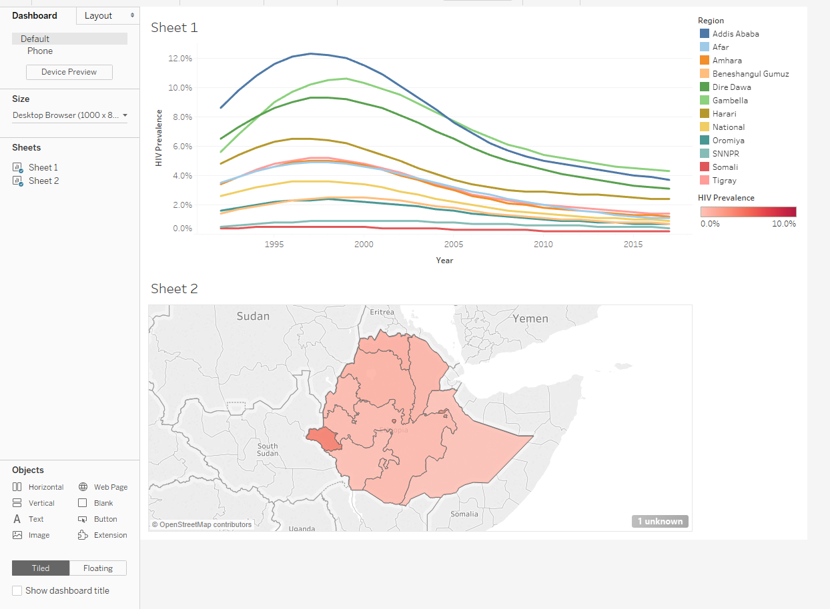
Dashboard
Create a new dashboard tab
Drag both sheets to dashboard

Slide 32
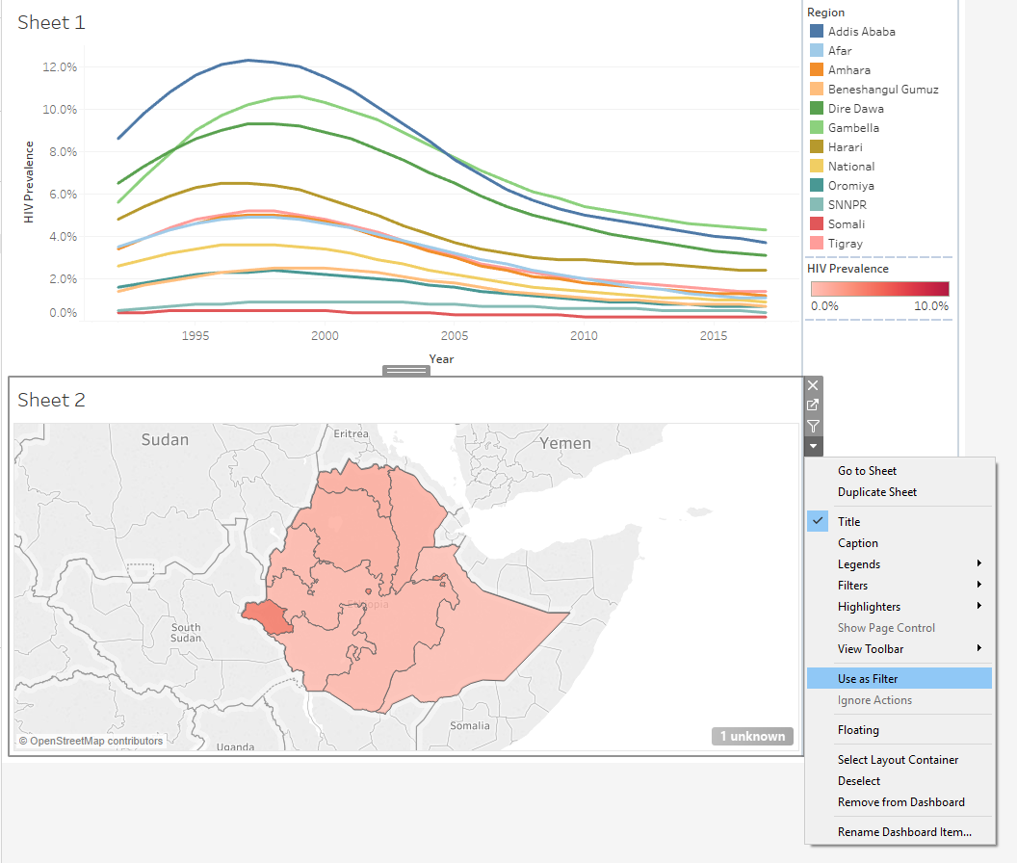
Connect Chart
More options
Use as Filter
Now when you click on a region, the first chart also change!

Slide 33
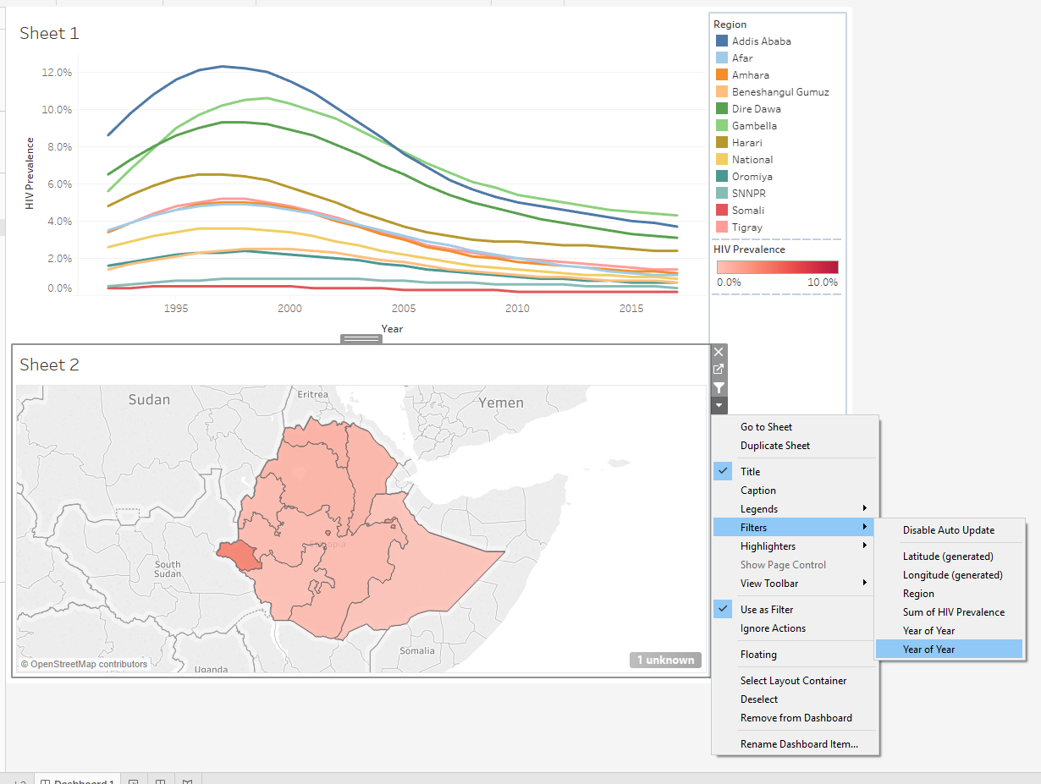
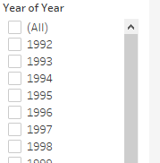
Add Time Slider
More options
Filters
Year of Year
Add year filter

Slide 34
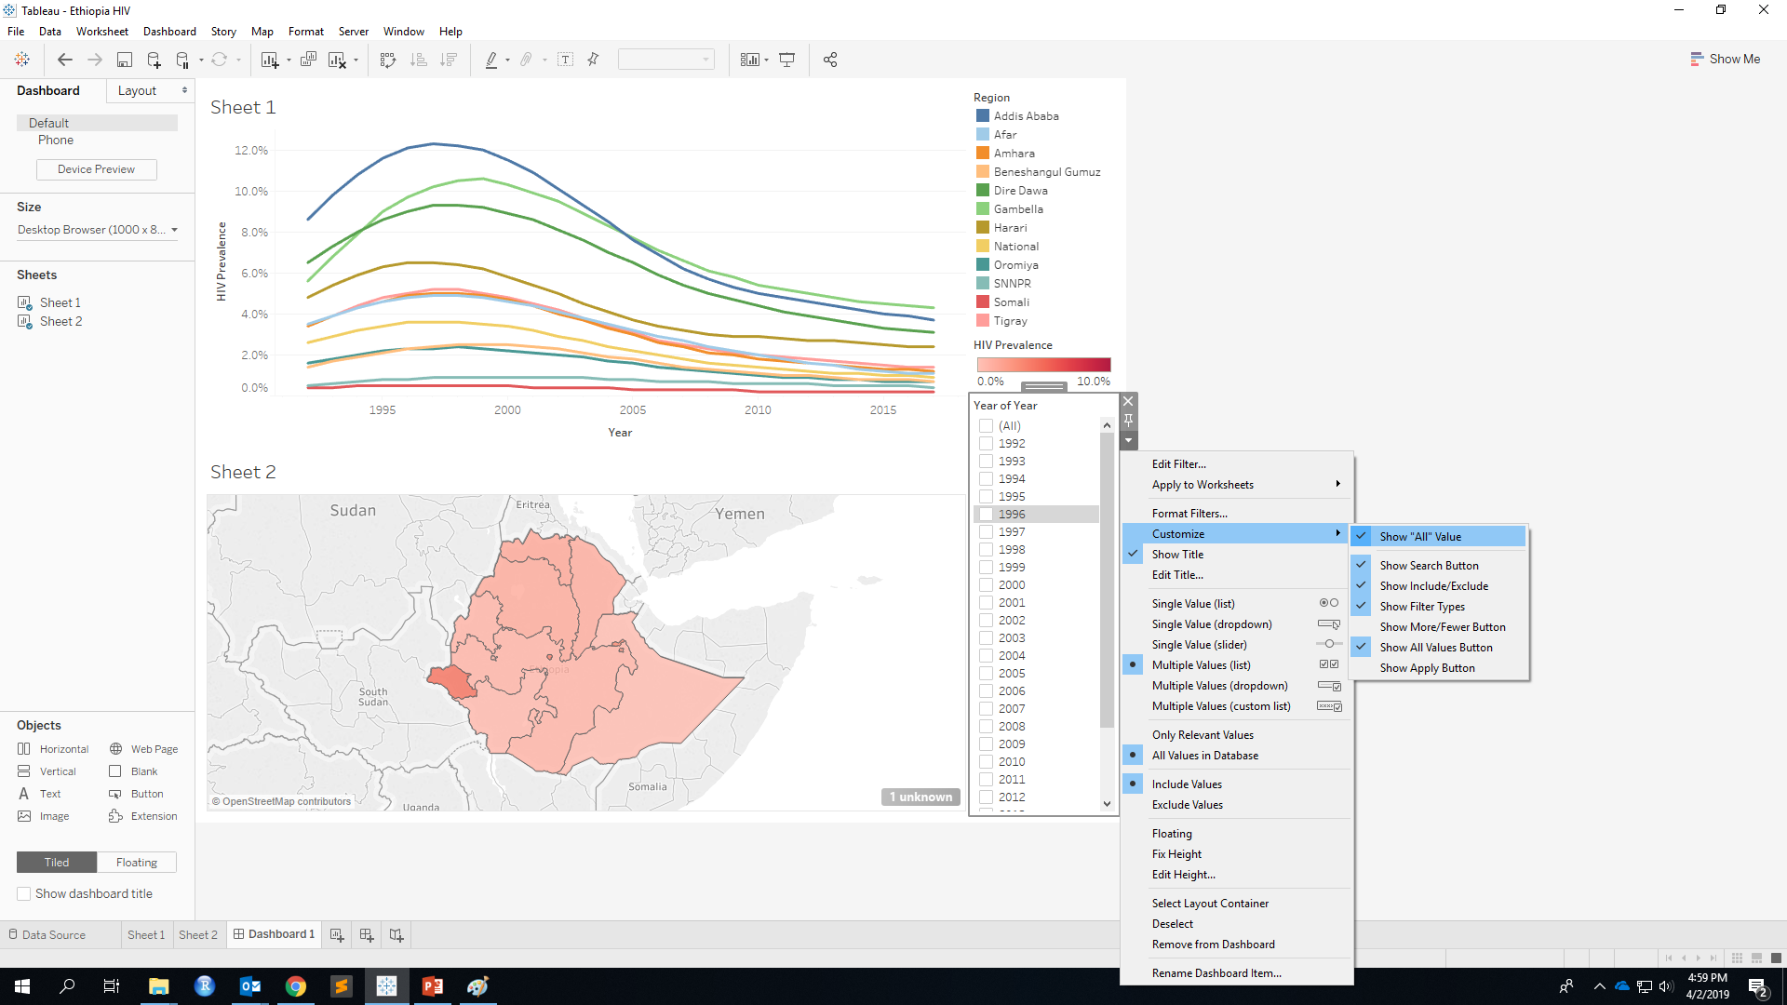
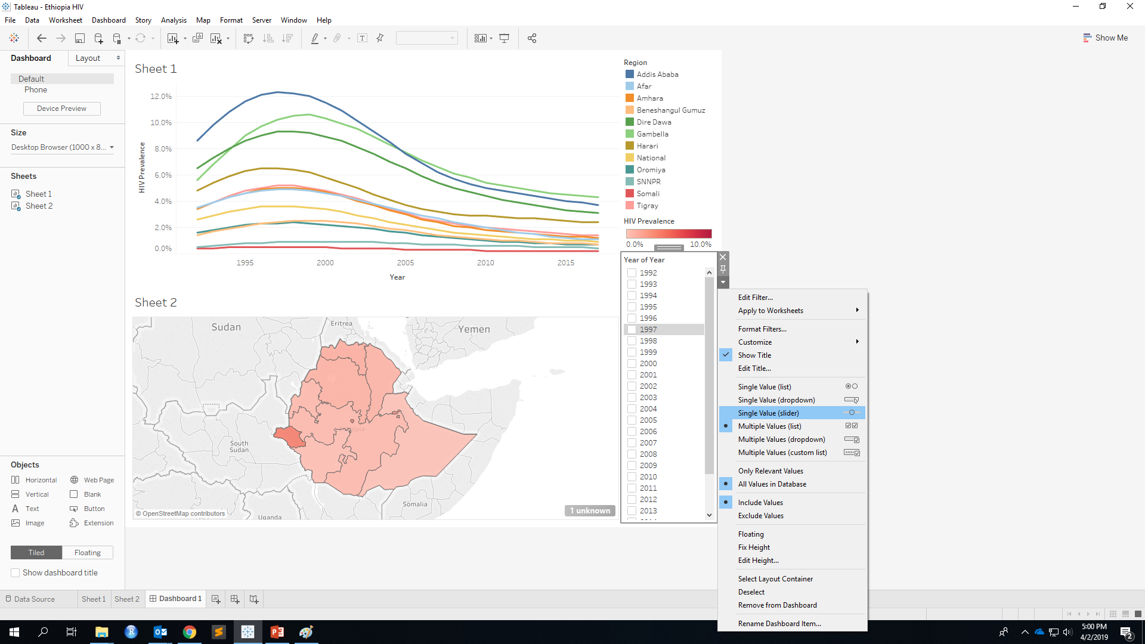
Add Time Slider
More options
Customize
Uncheck Show “All” Value
More options
Single Value (slider)

Slide 35

Customize Content
Change dashboard background color
Format -> Dashboard -> Dashboard Shading

Slide 36

Customize Content
Modify Title by double clicking on the title
Add object (text, image) by dragging object to dashboard

Slide 37
Customize Content
How to add YouTube video?
Drag a Webpage in to dashboard
Enter your modified YouTube link
Before
https://www.youtube.com/watch?v=Mg43RbYsBho
Keep ID and add “/embed/”
After
https://www.youtube.com/embed/Mg43RbYsBho

Slide 38

Dashboard Done!

Slide 39

Share Your Tableau Work (Tableau Desktop Only)
Extract data:
Data
HIV
Extract Data

Slide 40


Share Your Tableau Work (Tableau Desktop Only)
Extract data:

Slide 41


Share Your Tableau Work (Tableau Desktop Only)
Publish:
Server
Tableau Public
Save to Tableau Public
Sign in your Tableau Public Account

Slide 42

Share Your Tableau Work (Tableau Public Only)
Easy two steps!
1. “File” on the top
2. Save to Tableau Public

Slide 43

Your Work is Public!

Slide 44



CENTER FOR GLOBAL DATA VISUALIZATION
Designed to build data visualization capacity and strengthen a culture of data use in international development
Mobilizes the power of university students to close the gap in data visualization
Collaborating universities will have access to trainings and can publish research on the CGDV platform
http://www.centerforglobaldata.org
Notes:
Patrick- please add a visual or ask Jennifer to do this.

Slide 45



Share Your Tableau Work on CGDV
Find share button under your Tableau visual
Copy the Embed code when uploading visual on CGDV.

Slide 46
Thank You

